Slide 1


EP8900 – Integrated Assessment Modelling
South Africa Study Case for SSP3
Christine Hung, Cristina Iordan & Lorenzo Usai

Slide 2
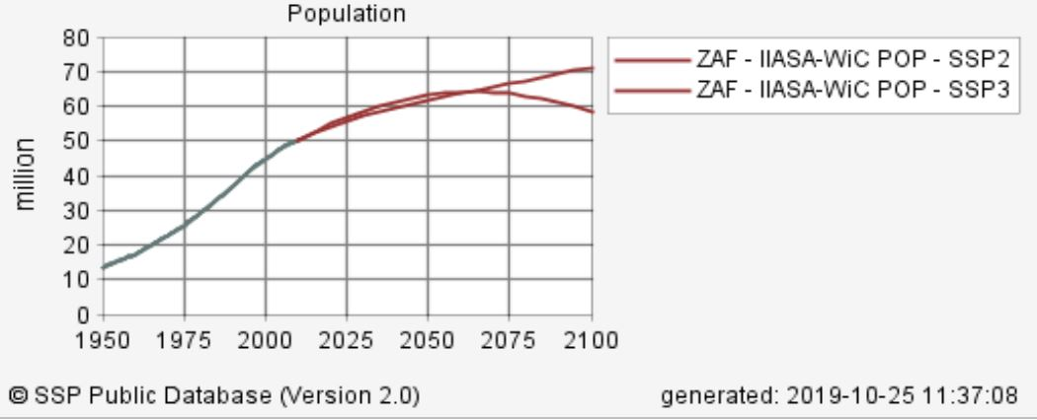
SSP3 – Narrative

Slide 3
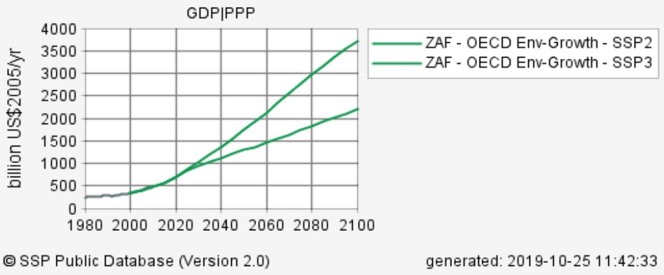
SSP3 – Narrative

Slide 4
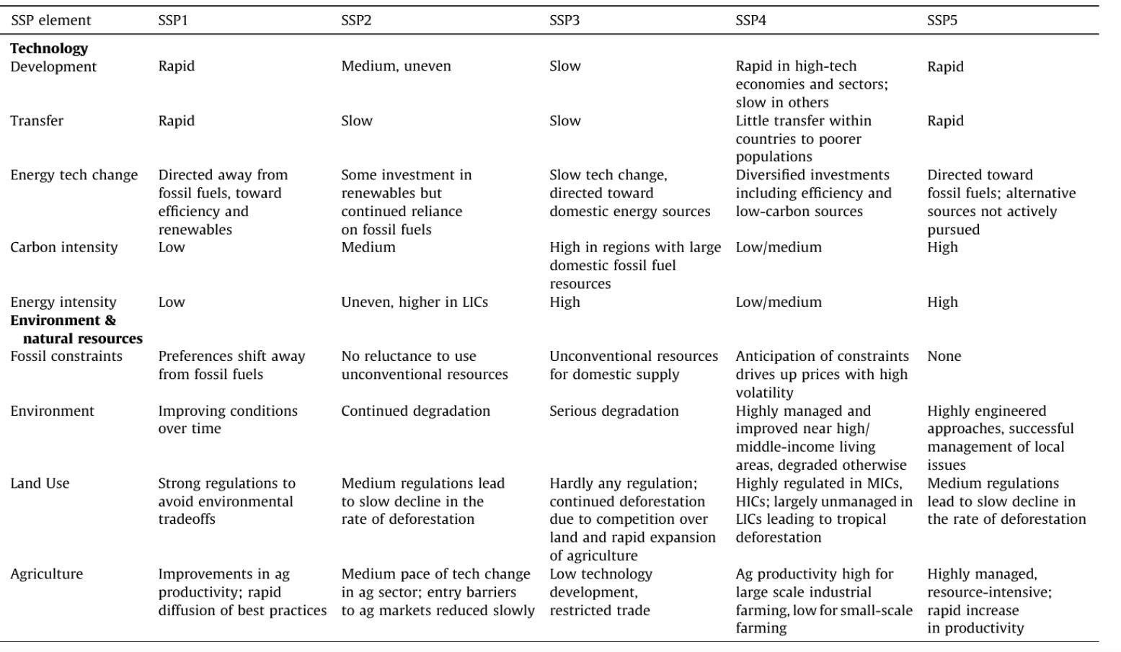
SSP3: Regional rivalry—A rocky road (international fragmentation)
O’Neill, Bin the 21st century. Global Environmental Change, 42, 169-180. . C., Kriegler, E., Ebi, K. L., Kemp-Benedict, E., Riahi, K., Rothman, D. S., ... & Levy, M. (2017). The roads ahead: Narratives for shared socioeconomic pathways describing world futures

Slide 5
Our adjusments to the original model
Coal costs : 1% increase per year (Fujimori)
Gas, oil, shale costs: 7.5% increase per year (Fujimori)
Coal and oil imports: 1.33% increase per year of base value (Fujimori)
Oil exports: reduced by 1.33% (Fujimori)
Investment costs :
coal ppl reduced timestep difference by 50%, (ensured continual decrease in investment cost)
gas_ppl reduced timestep difference by 50% [2020-2040], kept at 300 from 344 [2040-2070]
inv_cost: loil_ppl decrease from 600 to 550
nuc_ppl 2% decrease per year

Slide 6
Results

Slide 7
Further ideas
Take inn urbanization changes -> modify maybe transport demand

Slide 8
Thank you!

Slide 10
Breakdown
1. Coal mining cost (coal_extr) --> inv_cost, fix_cost, var_cost (increase of 1% per year)
2. var_cost: oil_imp to 1.33 of base value (Fujimori)
3. var_cost: gas_extr 7.5% increase per year (Fujimori)
4. var_cost: oil_extr 7.5% increase per year (Fujimori)
5. var_cost: shale_extr 7.5% increase per year (Fujimori)
6. var_cost: loil_imp 1.33 of base value
7. var_cost: coal_imp to 1.33 of base value
8. inv_cost: coal_ppl reduced timestep difference by 50%, ensured continual decrease in investment costs
9. inv_cost: foil_ppl decreased from 730 to 650 [2020 to 2070]
10. inv_cost: gas_ppl reduced timestep difference by 50% [2020-2040], kept at 300 from 344 [2040-2070]
11. inv_cost: loil_ppl decrease from 600 to 550
12. var_cost: nuc_ppl 2% decrease per year
13. var_cost: oil_exp reduced by 1.33
14. inv_cost: for solar_i, solar_pv, solar_th_ppl, solar_th_ppl_base, wind_ppl, reduce difference beteween decades by 0.25
15. fix_cost: for solar_i, solar_pv_ppl, solar_th_ppl, solar_th_ppl_base, wind_ppl, reduce difference beteween decades by 0.25
16a. capacity_factor: coal_gas, coal_i, coal_ppl, increased capacity factors from year 2030.
Techs from 2030 -> 5% increase, techs from 2040 and forward, 10% increase
16b. capacity_factor: nuc_ppl, increased capacity factor by 4% in 2030 (from 71% to 75%) and by 7% from 2040 (form 71% to 78%)
17. GDP: Calibrated the GDP according to the SSP public database for SSP3, based on OECD GDP

Slide 11
SSP3: Regional rivalry—A rocky road (international fragmentation)
A resurgent nationalism
Concerns about competitiveness and security
Regional conflicts - > countries increasingly focus on domestic (at most, regional issues)
Limited number of comparatively weak global institutions
Uneven coordination and cooperation for addressing environmental (or global concerns)
Policies towards national and regional security issues
including barriers to trade
particularly in the energy resource and agricultural markets
Countries focus on achieving energy and food security goals within their own regions
at the expense of broader-based development, and in several regions move toward
more authoritarian forms of government with highly regulated economies.
Investments in education and technological development decline.
Economic development is slow, consumption is material-intensive,
and inequalities persist or worsen over time, especially in developing countries.
There are pockets of extreme poverty alongside pockets of moderate wealth,
with many countries struggling to maintain living standards and provide access to safe water,
improved sanitation, and health care for disadvantaged populations.
A low international priority for addressing environmental concerns leads to strong environmental degradation in some regions. The combination of impeded development and limited environmental concern results in poor progress toward sustainability. Population growth is low in industrialized and high in developing countries. Growing resource intensity and fossil fuel dependency along with difficulty in achieving international cooperation and slow technological change imply high challenges to mitigation.
The limited progress on human development,
slow income growth
lack of effective institutions.

